Slide 1

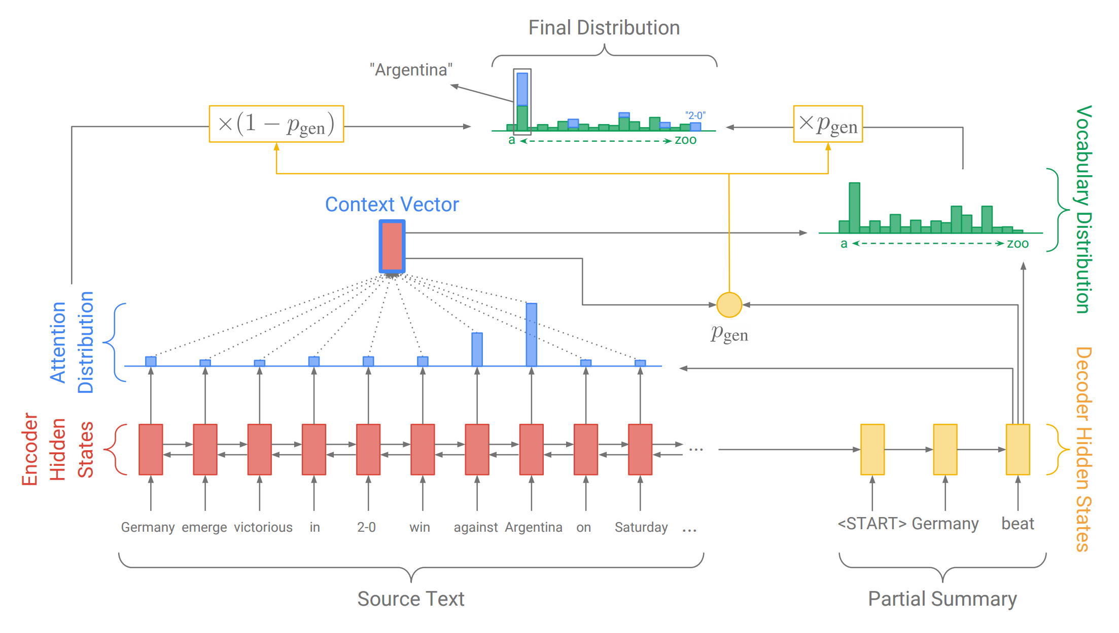
Bengali Text Summarization
Md Mahfuzur Rahaman, Sujoy Nath, Shahnur Islam
Shahjalal University of Science and Technology, Sylhet
1
Introduction
5
Conclusion
Summarization is the task of condensing a piece of of text to a shorter version that contains the main information from the original.
There are two basic approach to summarization :extractive and abstractive.
Extractive is where the machine text actual context and uses as the summary.
Abstractive is a technique used to mimic .This method makes the summarization more condense and human like
Here we have tested both of the methods and have decided to develop abstractive summarization to our project
Lots of work have been done so far for English Text Summarization but a few attempt have been made for Bengali Text Summarization.
We have tried to develop a Bengali text summarizer . We have tested the existing methodology and finally we have chosen the sequence to sequence RNN model .
We believe that our work is significant because we design our user study to prioritize human significance rather than simply mathematical significance
In this semester we have worked this method for English text summarization further we will modify and train this model for our Bengali dataset which will provide the actual summary of Bengali document
2
Methods
4
Data
For Extractive Summarization we have used Bengali document from Bengali online newspaper .
For Abstractive summarization we have used English dataset from the news collection by the associated press world wide from English Gigaword.
3
Results
Summary
English News
Abstractive Summarization
Bengali News
Extractive Summarization
For Extractive Summarization we have used TF-IDF. Here is given an output for extractive summarization
.
Original Bengali Document | Summarize Bengali Document
For Abstractive Summarization we have used sequence to sequence RNN model .Here is given an output of abstractive summarization
Original English Document | Summarize English Document

